Slide 1


Housing: Price Prediction
BY
LAVINA VAIDYA

Slide 2
AGENDA
Introduction
Problem Statement
Problem Understanding
What is Housing Price Prediction?
Importance of Housing Price Prediction
Benefits of Housing Price Prediction
Data Analysis
Exploratory Data Analysis

Slide 3
Visualizations
Data Analysis Steps Done
Assumptions
Model Building
Saving the model and prediction results
Conclusion

Slide 4
INTRODUCTION
Housing prices are the amount of money that a buyer pays for a housing unit such as a house, condo, or apartment. Housing prices are influenced by a variety of factors such as location, size, amenities, and quality of construction. In addition, factors such as the local economy, interest rates, and availability of housing can also affect housing prices. Housing prices can also be affected by national and global economic conditions. Housing prices also tend to increase over time, as demand for housing increases and supply remains limited.

Slide 5
PROBLEM STATEMENT
A US-based housing company named Surprise Housing has decided to enter the
Australian market . The company uses data analytics to purchase houses at a price below
their actual values and flip them at a higher price. For the same purpose, the company has
Collected a data set from the sale of houses in Australia.
The company is looking at prospective properties to buy houses to enter the market.
You are required to build a model using Machine Learning in order to predict the actual
value of the prospective properties and decide whether to invest in them or not. For this
company wants to know:
Which variables are important to predict the price of variable?
How do these variables describe the price of the house?

Slide 6
PROBLEM UNDERSTANDING
House prices increase every year. House prices trends are not only the concerns for buyers and sellers, but they also indicate the current economic situations. Therefore, it is important to predict the house prices without bias to help both buyers and sellers make their decisions.
So, there is a need for a system to predict house prices in the future. House price prediction can help the developer determine the selling price of a house and can help the customer to arrange the right time to purchase a house.
In real estate the value of property usually increases with time as seen in many countries. One of the causes for this is due to rising population. The value of property depends on the proximity of the property, its size its neighborhood and audience for which the property is subjected to be sold. So, machine learning models helps buyers and sellers to understand the house price of particular time.

Slide 7
What is Housing Price Prediction?
Housing price prediction is a process of predicting the future value of a house or other real estate property. This prediction is based on various factors such as market conditions, location, amenities, and historical data. Predictions can help buyers and sellers make informed decisions about their housing investments.

Slide 8
IMPORTANCE OF HOUSING PRICE PREDICTION
Housing price prediction is an important tool for buyers, sellers, and real estate investors. It helps buyers by providing them with an estimate of how much a home will be worth in the future, so they can make an informed decision about when and how much to offer. It helps sellers by giving them an idea of how much their property is worth, so they can price it competitively. Finally, it helps real estate investors by providing an indication of future property values, so they can make informed decisions about which properties to purchase.

Slide 9
BENEFITS OF HOUSING PRICE PREDICTION
1. Improved Decision Making: One of the main benefits of housing price prediction is that it can help people make more informed decisions when buying or selling a home. This can help buyers make sure they are not overpaying for a house and can help sellers ensure they are getting a fair market price.
2. Greater Efficiency: By utilizing housing price prediction, buyers and sellers can save time and money. The predictions can help people find homes that fit their budget and give them an idea of what they should expect to pay. Additionally, sellers can use the predictions to set a fair price for their home and save time by not spending it on marketing and advertising.
3. Improved Market Stability: With housing price prediction, people can better understand the market and make more informed decisions. This can help to stabilise the market and create a more efficient system. This can also help to reduce speculation in the market, which can lead to more consistent and accurate housing prices.

Slide 10
DATA ANALYSIS AND VISUALIZATION
There are two datasets. One is train dataset which is supervised and another one is test dataset which is unsupervised. The target variable is “SalePrice” and it is a regression type problem. I have used train dataset to build machine learning models and then by using this model I made prediction for the test dataset.
Firstly, I have to treat test dataset. I checked for null values, in some columns null values are more than 50% so we drop them, similarly in some columns zero values are greater than 70% I dropped then also. I treated train dataset for null values and fill them but before that I differentiate the data frame in categorical and numerical column then numerical columns null value fill with mean and categorical column fills with mode value

Slide 11
After treating null values and zero values I dropped some columns which find to irrelevant relation to our target variable, then I am going for visualization part to fling relation with target variable(bivariant visualization)
Now its time to find skewness treated them and create a new data frame without outliers.
After finishing this I go for regration model find best fil model and make predication for given test data.

Slide 12
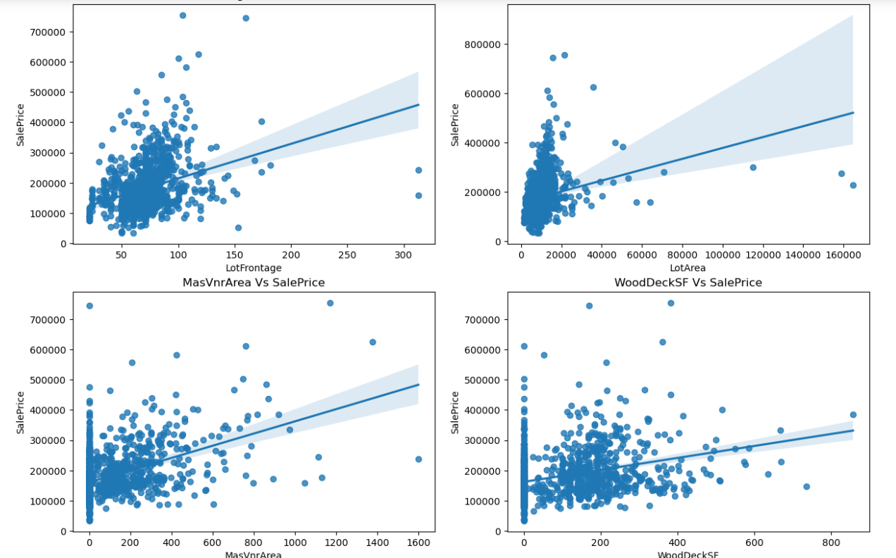
Exploratory Data Analysis

Slide 13
Observations:
• SalePrice vs LotFrontage: From the plot we can observe there is no much linear relation between the label and feature. If the linear feet of street connected to property is more, the sale price is also high.
• SalePrice vs LotArea: There is weakly positive linear relation between the label and feature. But the sale price is high when lot size has around 20000 square feet area. Also as the lot size increases the price is also increasing moderately.
• SalePrice vs MasVnrArea: There is bit positive linear relation between feature and target. Also the sale price is high when Masonry veneer area has around 50-400 square feet. So as the masonry veneer area in square feet increases sale price is also increasing.
• SalePrice vs WoodDeckSF: There is weakly positive linear relation between the feature and target. As the Wood deck area increases, sale price is also increases.

Slide 14
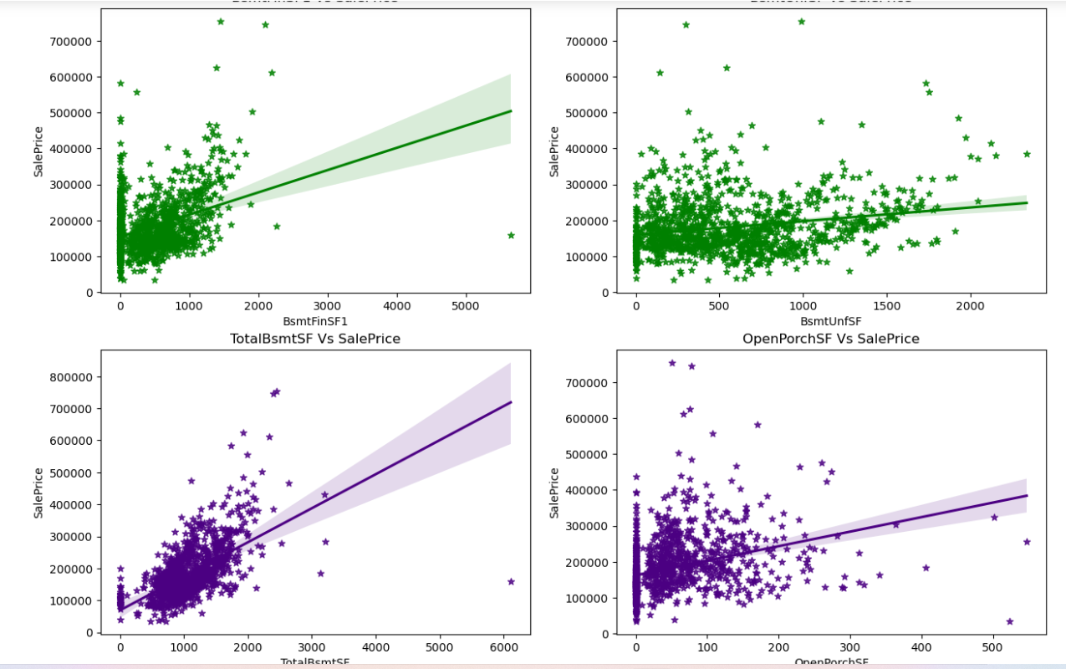

Slide 15
Observations:
• SalePrice vs BsmtFinSF1: There is weakly positive linear relation between feature and label. The sale price is high that is 100000-300000 when basement square feet lie upto 1500 square feet. So as the type 1 basement finished square feet increases, sale price is also increases.
• SalePrice vs BsmtUnfSF: There is positive linear relation between the target and BsmtUnfSF. When the unfinished basement area is below 1000 square feet, the sale price is high.
• SalePrice vs TotalBsmtSF: There is positive linear relation between sale price and TotalBsmtSF. As total basement area increases, sale price also increases.
• SalePrice vs OpenPorchSF: There is a linear relation between the label and feature. The sale price is high when Open porch area is below 200sf. Here also as the Open porch area increases, sale price is also increases.

Slide 16
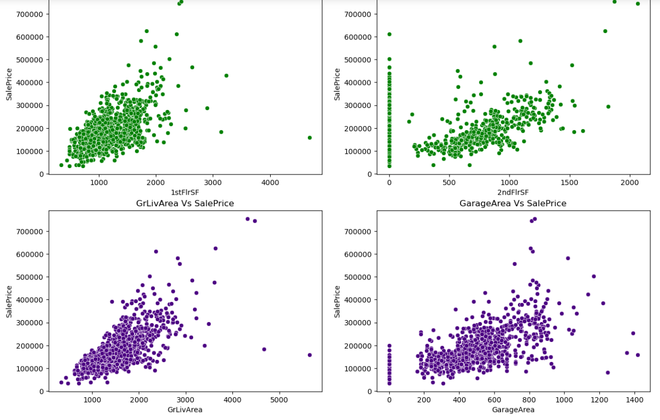

Slide 17
Observation:
• SalePrice vs 1stFlrSF: There is a linear relation between the label and feature. As we can observein the plot, the sale price is high when the first floor area lies between 500-2000 square feet. So as the 1st floor area increases, sales price also increases moderately.
• SalePrice vs 2ndFlrSF: There is a positive correlation between SalePrice and 2ndFlrSF. So it is obvious that the sale price increases based on the floors.
• SalePrice vs GrLivArea: Most of the houses have above grade living area. There is a positive correlation between the label and feature. Here as the above grade living area increases, sale price also increases.
• SalePrice vs GarageArea: Similar to 2nd floorSF, here also positive linear relation between the label and feature. As size of garage area increases, sale price also increases. The sale price is high when size of garage area is between 200-800 square feet.

Slide 18
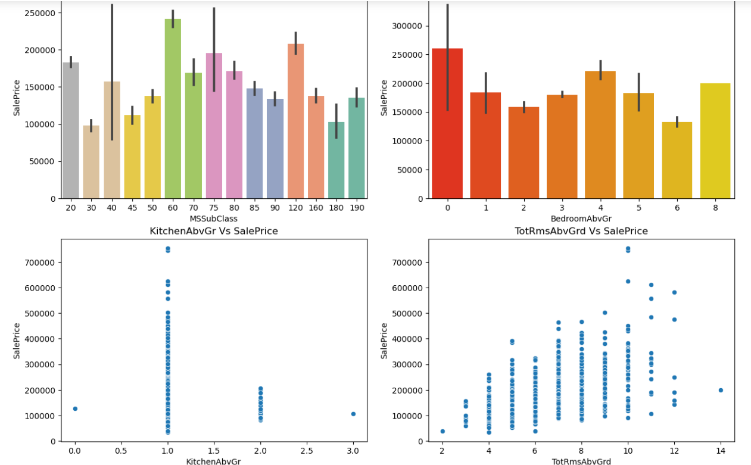

Slide 19
Observations:
• SalePrice vs MSSubClass: The sale price is high for the MSSubClass 60,120 and 20. • SalePrice vs BedroomAbvGr: Many houses are having 0 and 4 bedrooms have high sales price also houses having 8 bedrooms also have high sales price. Other bedroom grades have average sale price.
• SalePrice vs KitchenAbvGr: Most of the houses have single kitchen and few houses have 2 kitchens. The sale price is also high in case of the houses having single kitchen.
• SalePrice vs TotRmsAbvGrd: We can observe some linear relation between Total rooms above grade and Sale Prices as the number of rooms increases the sale price also increases.

Slide 20
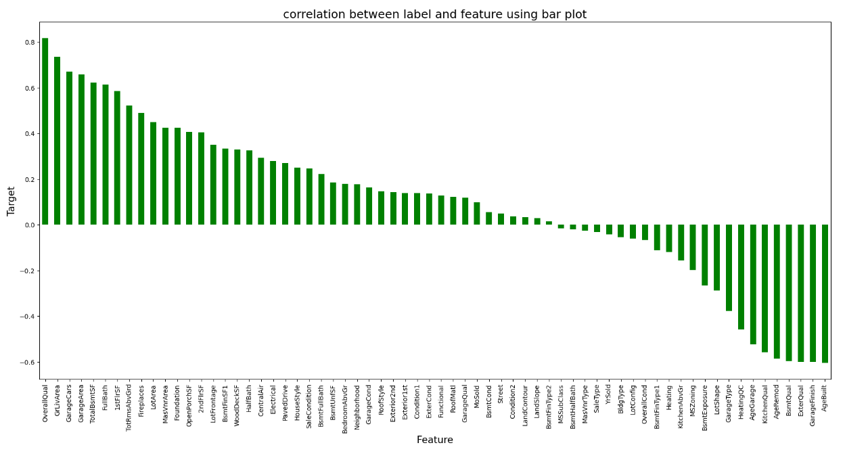

Slide 21
Features having high Positive correlation with label
• OverallQual
• GrLivArea
• ExterQual
• KitchenQual
• BsmtQual
• GarageCars
• GarageArea
• TotalBsmtSF
• 1stFirSF
• FullBath
• TotRmsAbvGrd

Slide 22
Features having high Negative correlation with label
• Heating
• MSZoning
• LotShape
• BsmtExposure
• GarageType
• AgeRemod
• AgeGarage
• AgeBuilt
• GarageFinish

Slide 23
DATA ANALYSIS STEPS DONE
I have treated null values by imputation techniques.
I have done feature engineering steps like feature extraction and feature selection to improve data normality and linearity.
Identified skewness using distribution plots and removed skewness using power transformation method
Encoded data using Label Encoder.
Used correlation coefficient to check the correlation between dependent and independent variables. To visualize the correlation I have used heatmap and bar plot.
I have used Standard Scalarization method to scale the data.
Handled the multicollinearity issue by finding VIF values.
Split train and test to build machine learning models. Models building process will be shown in the further steps.

Slide 24
Assumptions:
Firstly, from the problem statement which states that it is a Regression type problem for which we will be using Regressor algorithms to build our models and predict the sale price of the house.
Secondly, based upon the analysis and visualization part we have seen some of the features having linear relation with label. So, I assumed these features helps in model building and to predict the sale price of the house. Also, these features play and important role as if someone planned to buy a house he/she can decide whether to buy house or not based on these features like environment, area, quality of the house etc.
So, I suggest that people take into consideration the features that were deemed as most important as seen in this study might help them estimate the house price better.

Slide 25
Model Building:
In this problem SalePrice is our target variable which is continuous in nature, from this I can conclude that it is a regression type problem hence I have used following regression algorithms to predict the sale price of the house.
After the pre-processing and data cleaning I left with 66 columns including target and I used them features for prediction
* Linear Regression
* Lasso Regressor
* Ridge Regressor
* Random Forest Regressor
* Extra Trees Regressor
* Gradient Boosting Regressor
* Bagging Regressor
I have got the best random state and maximum R2 score and then created train test split to build the above models.

Slide 26
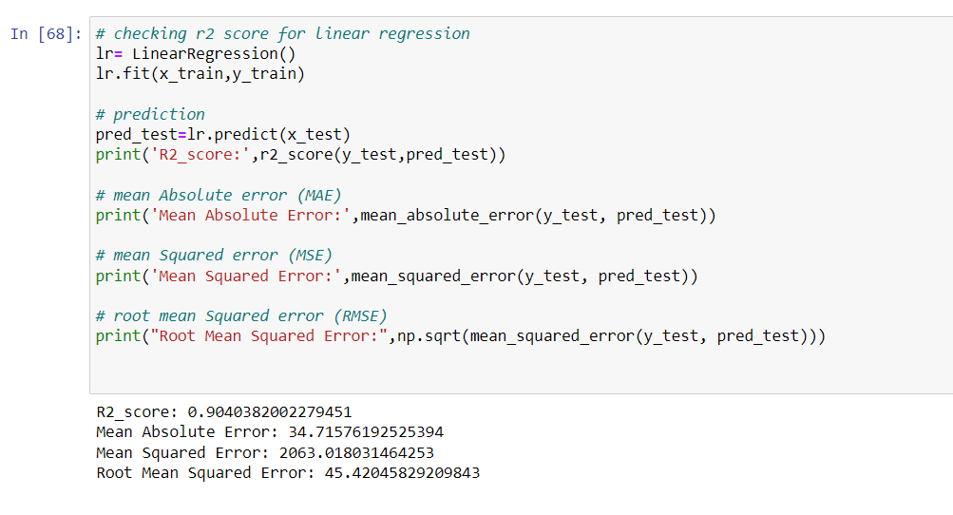
Linear regression Linear regression

Slide 27
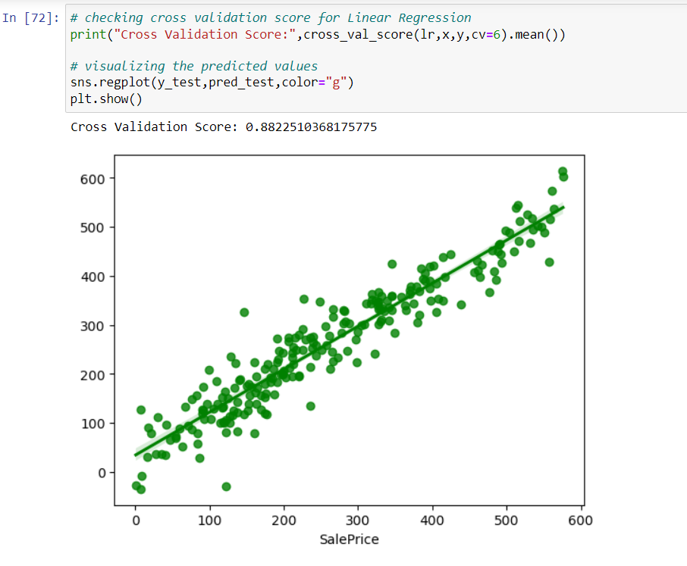

Slide 28
Created linear regression model and getting 0.8976 R2 score using this model. From the above plot we can observe the sales price of the house. The best fit line shows there is strong linear relation between test data of trained model and predicted values.

Slide 29
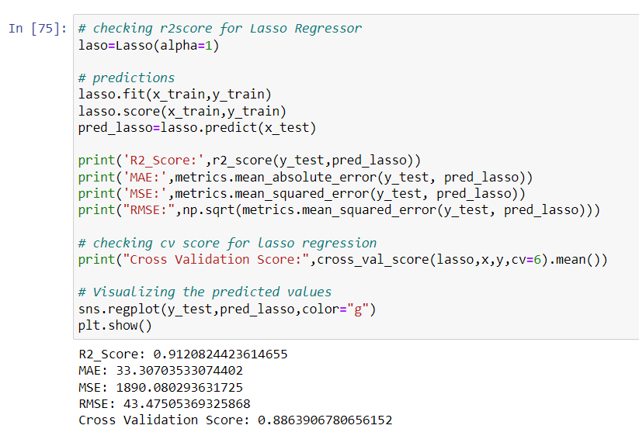
REGULARIZATION Lasso Regressor

Slide 30
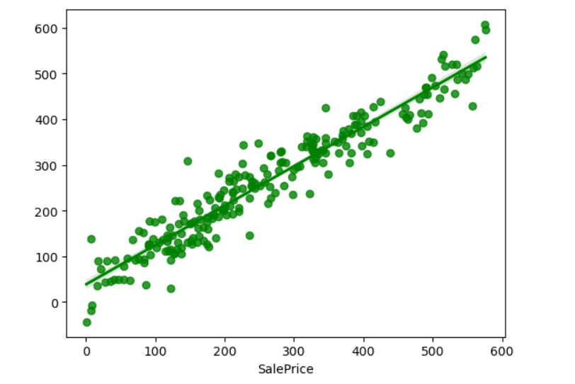
Created Lasso regressor model and getting 0.90 R2 score using this model. From the above plot we can observe the sales price of the house. The best fit line shows there is strong linear relation between test data of trained model and predicted values.

Slide 31
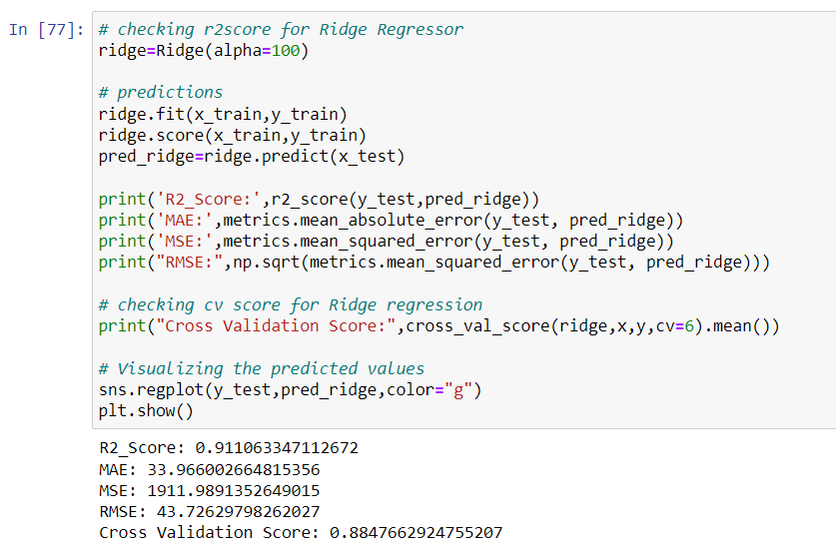
Ridge Regressor

Slide 32
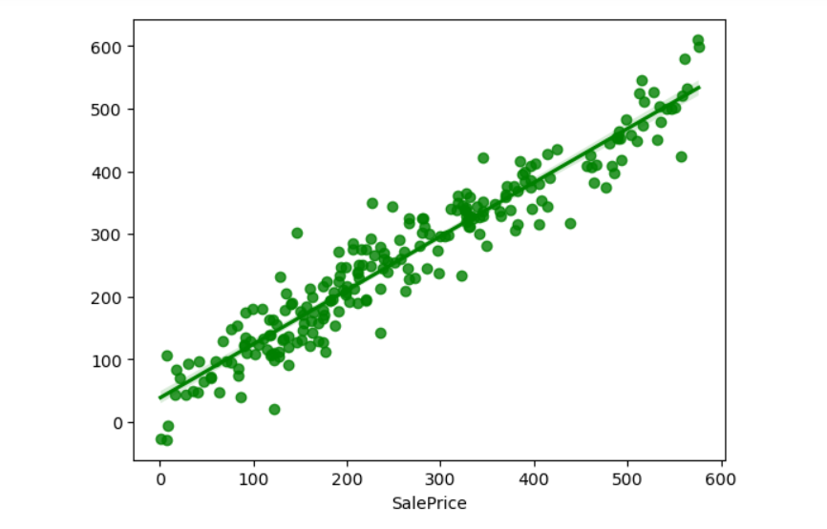
Created Ridge regressor model and getting 0.9059 R2 score using this model. From the above plot we can observe the sales price of the house. The best fit line shows there is strong linear relation between test data of trained model and predicted values.

Slide 33
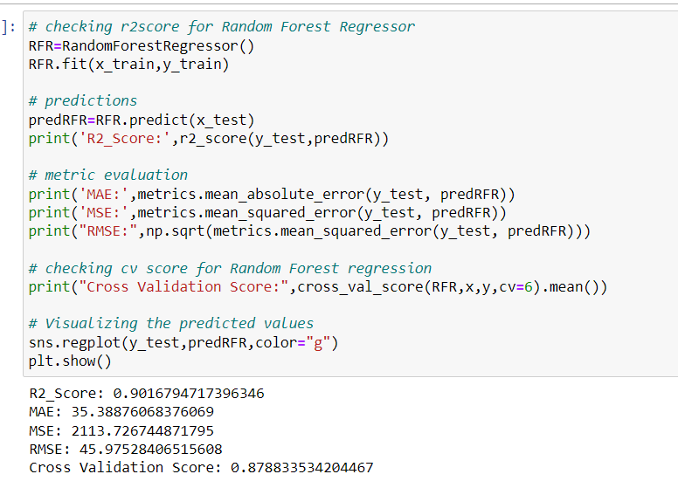
ENSEMBLE TECHNIQUES Random Forest Regressor

Slide 34
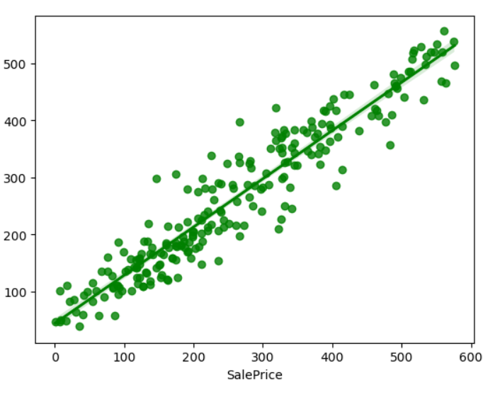
Created Random Forest Regressor model and getting 0.9013 score using this model. From the above plot we can observe the sales price of the house. The best fit line shows there is strong linear relation between test data of trained model and predicted values.

Slide 35
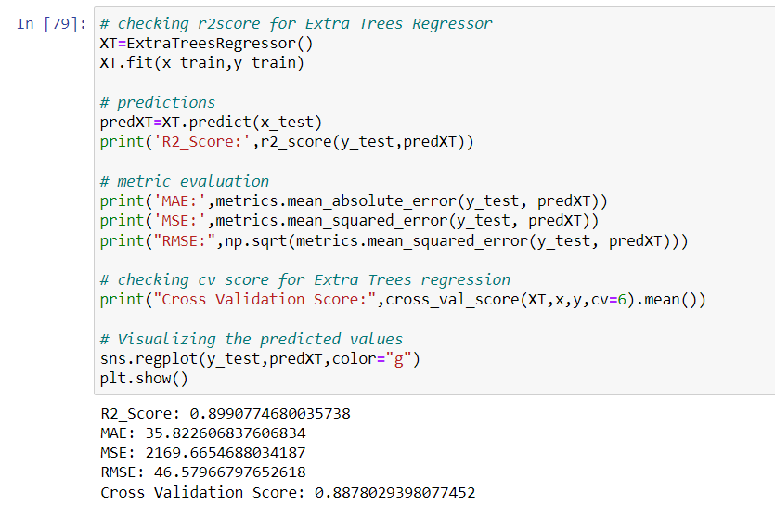
Extra Trees Regressor

Slide 36
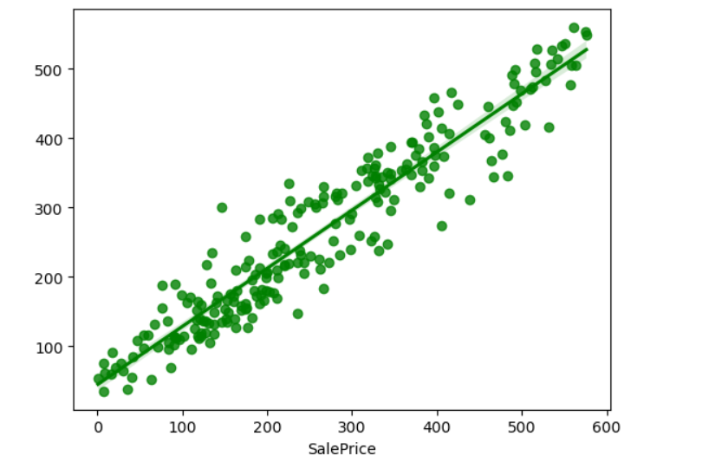
Created Extra Trees Regressor model and getting 0.8878 score using this model. From the above plot we can observe the sales price of the house. The best fit line shows there is strong linear relation between test data of trained model and predicted values.

Slide 37
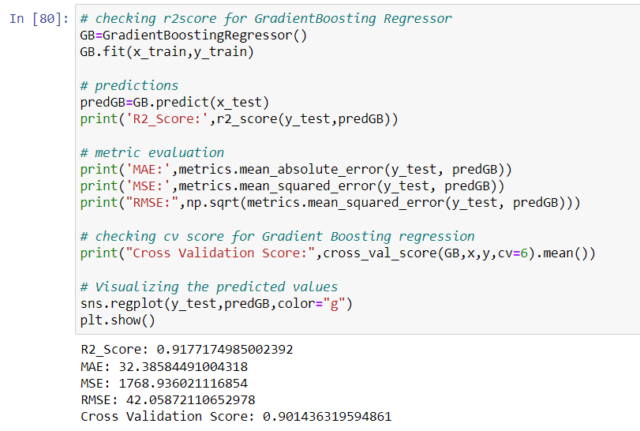
Gradient Boosting Regressor

Slide 38
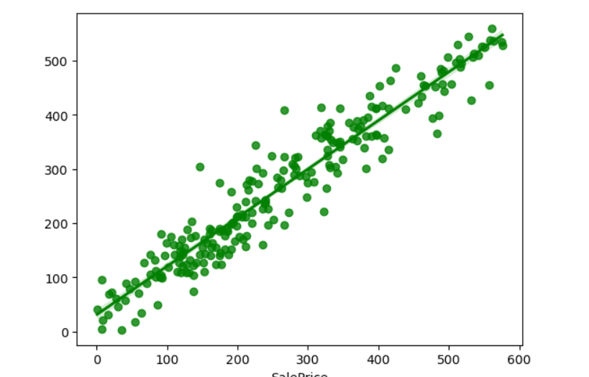
Created gradient boosting Regressor model and getting 0.9177 score using this model. From the above plot we can observe the sales price of the house. The best fit line shows there is strong linear relation between test data of trained model and predicted values

Slide 39
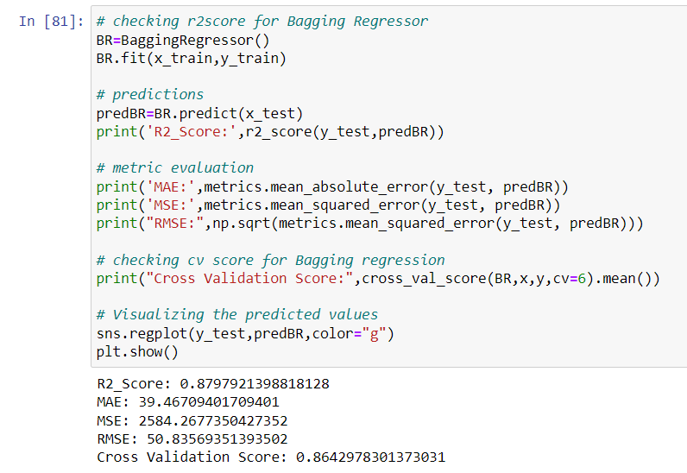
Bagging Regressor

Slide 40
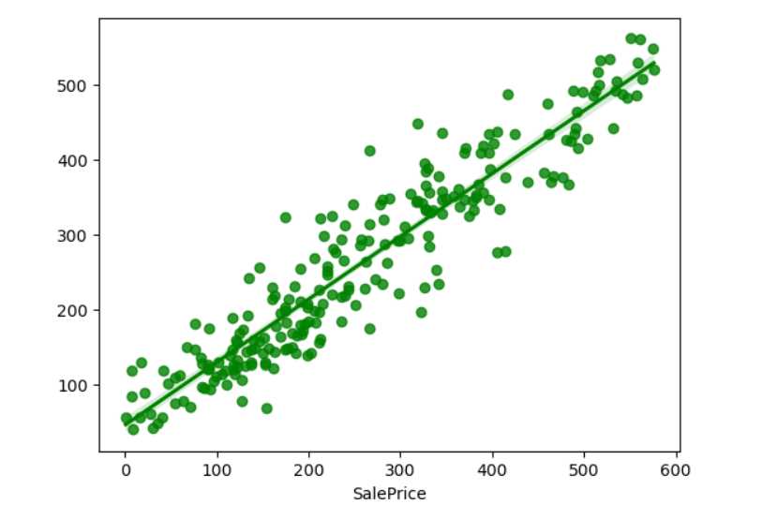
Created bagging Regressor model and getting 0.8797 score using this model. From the above plot we can observe the sales price of the house. The best fit line shows there is strong linear relation between test data of trained model and predicted values.

Slide 41
Difference between R2 score and Cross Validation Score
Linear Regressor = 1.70%
Lasso Regressor = 2.24%
Ridge Regressor = 2.26%
Random Forest Regressor = 1.82%
Extra Trees Regressor = 1.45%
Gradient Boosting Regressor = 1.91%
Bagging regressor=2.64%
From the difference between R2 score and Cross validation score I can conclude that Linear Regressor as my best fitting model as it is giving less difference compare to other models.

Slide 42
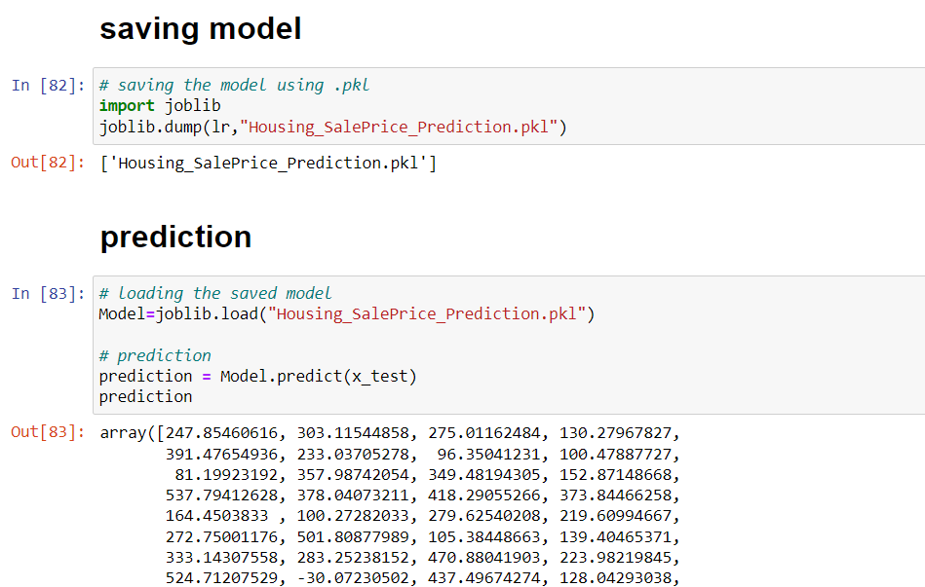
Saving model and prediction

Slide 43
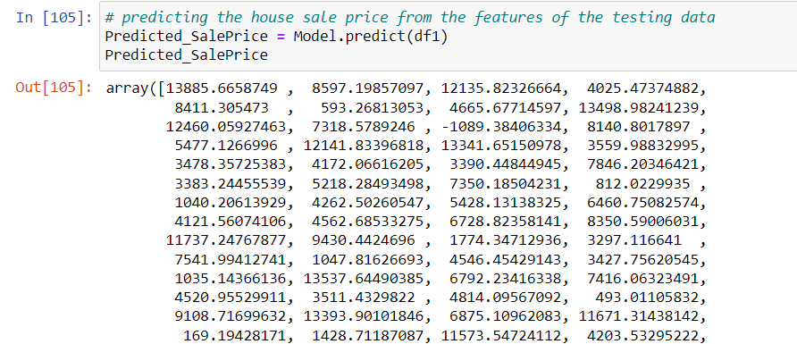
Predicted values from test dataset

Slide 44
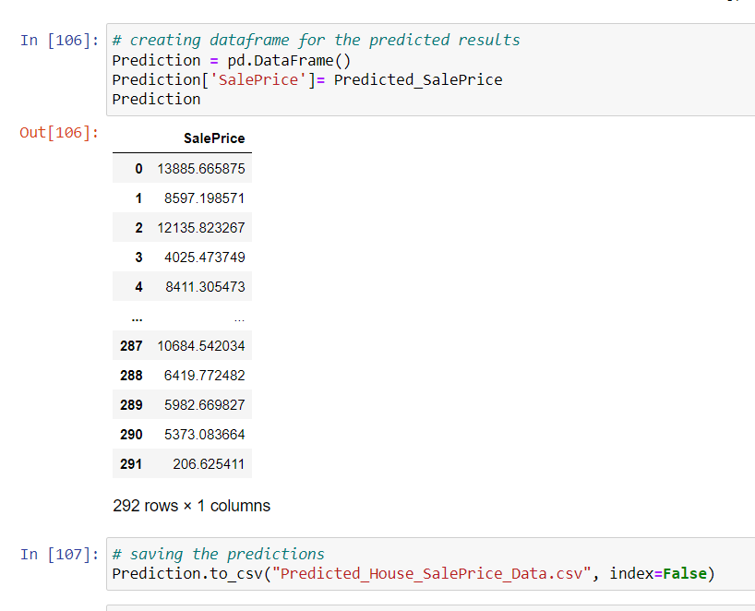
Make dataframe of predicted model and save the prediction

Slide 45
CONCLUSION
In this study, we have used multiple machine learning models to predict the house sale price. We have gone through the data analysis by performing feature engineering, finding the relation between features and label through visualizations. And got the important feature and we used these features as inputs to predict the price by building ML models.
We have got good prediction results. And predicted the sale price for test data using saved best model.
Finally, our aim is achieved by predicting the house price for the test data, I hope this will be further helps for sellers and buyers to understand the house marketing. The machine learning models and data analytic techniques will have an important role to play in this type of problems. It helps the customers to know the future price of the houses.
As a recommendation, I advise to use this model by the people who want to buy a house In the area covered by the dataset to have an idea about the actual price. The model can be used also with datasets that cover different cities and areas provided that they contains the same features. I also suggest that people take into consideration the features that were deemed as most important as seen in this study might help them estimate the house price better.

Slide 46
References:
https://www.academia.edu/38358601/House Price Prediction
https://www.geeksforgeeks.org/house-price-prediction-using-machine-learning-in-python/
https://www.researchgate.net/publication/342302491Housing Market Prediction Problem using Different Machine Learning Algorithms A Case Study
https://scholarworks.sjsu.edu/cgi/viwecontent.cgi?article=1540& context=etd projects
https://www.kaggle.com/competitions/house-prices-advanced-regression-techniques

Slide 47
THANK YOU

